Slide 1
PBLA Overview
PBLA PD Session for New Instructors

Slide 2
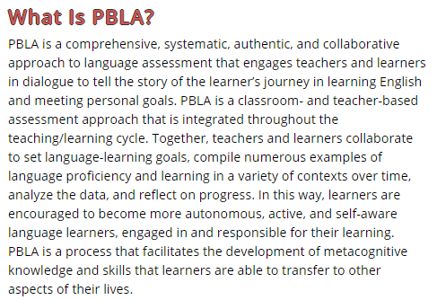
What is PBLA?
Portfolio-Based Language Assessment
Way to assess learners based on a body of evidence
Based on ability, not knowledge
Not calculated based on scores, percentages, or exams
http://pblaepg.language.ca/part-a-pbla-background/introduction-to-pbla-benefits-and-features/

Slide 3
PBLA Steps
Portfolio Review

Slide 4
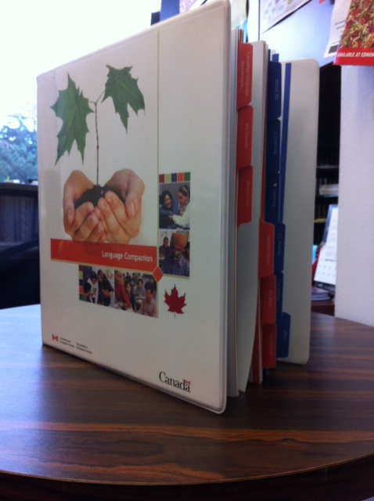
Portfolio Review
End goal
PBLA Guidelines:
8-10 artefacts in each section
“As a general rule, the benchmarks assigned to a learner… mean that the learner has achieved, and demonstrated, the level of communicative ability associated with most or all (traditionally, 70 to 100%) of the descriptors for the benchmarks assigned in each of the four skills.”
National Language Placement and Progression Guidelines, CIC, 2013, p. 3

Slide 5
Portfolio Review
Review each skill area to see what evidence they have collected
Keep track of results as you go along
Does the student have evidence to support 70-100% of the descriptors for your level in each skill?
CLB 2012, p. 6-7

Slide 6
PBLA Steps
Real-World Assessment Tasks
Portfolio Review

Slide 7
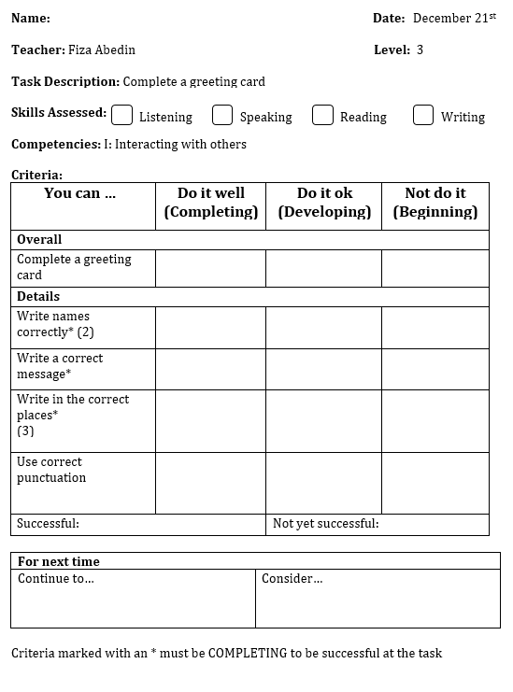
Real-World Assessment Tasks
Ability/action (not knowledge)
Tell the doctor which body part hurts (vs. label parts of the body on a diagram)
Level Appropriate
Task relates to a CLB Competency
Criteria relate to Indicators of Ability
Shows whether the student was successful
Learner-friendly language
Many types of tools to choose from
Must go in the portfolio

Slide 8
PBLA Steps
Skill-Using Activities
Real-World Assessment Tasks
Portfolio Review

Slide 9
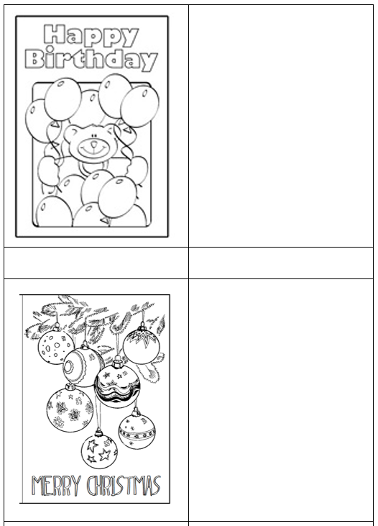
Skill-Using Activities
Also called free practice / communicative practice / study practice
Practice for the assessment task
Shows the student’s ability (not knowledge)
Still relates to a CLB competency
Not formally assessed, but teacher may still give feedback
Can go in the portfolio as supporting evidence

Slide 10
PBLA Steps
Skill-Building Activities
Skill-Using Activities
Real-World Assessment Tasks
Portfolio Review

Slide 11
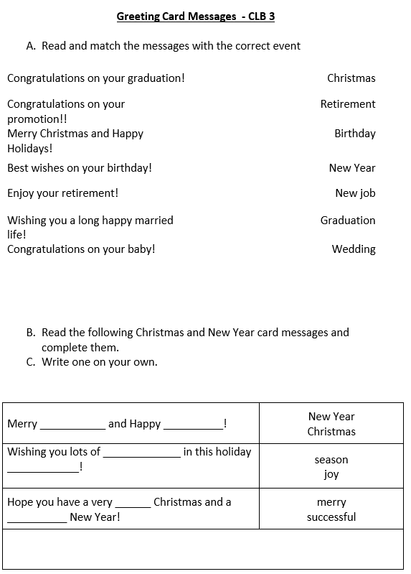
Skill-Building Activities
Also called study focus / controlled practice / guided practice
Focus on isolated parts
Typical examples include:
Grammar worksheets
Vocabulary matching/labeling
Drills/repetition
Fill in the blank
Cannot go in the portfolio as evidence

Slide 12
PBLA Steps
Lesson/ Assessment Plans
Skill-Building Activities
Skill-Using Activities
Real-World Assessment Tasks
Portfolio Review

Slide 13
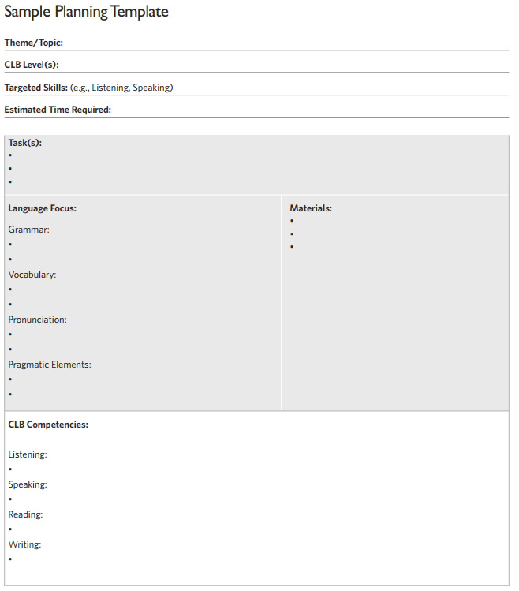
Lesson / Assessment Plans
Plan the progression from skill-building to skill-using to assessment task
Need to have the assessment task in mind from the beginning
No set/formal style
May be one class at a time, or may be the plan for multiple classes leading up to one assessment
CLB Support Kit, p. 32

Slide 14
PBLA Steps
Module Plans
Lesson/ Assessment Plans
Skill-Building Activities
Skill-Using Activities
Real-World Assessment Tasks
Portfolio Review

Slide 15
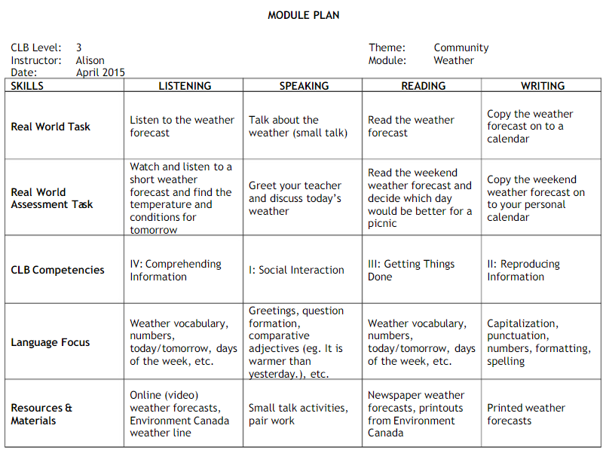
Module Plans
Plan for multiple assessments within the same theme/topic
Health – Finding a Doctor
Listening:
Listen to someone tell you about whether they like their doctor
Speaking:
Ask for information about a clinic
Reading:
Read information about a clinic to decide if you should go there
Writing:
Copy directions to the clinic

Slide 16
PBLA Steps
Needs Assessment
Module Plans
Lesson/ Assessment Plans
Skill-Building Activities
Skill-Using Activities
Real-World Assessment Tasks
Portfolio Review

Slide 17
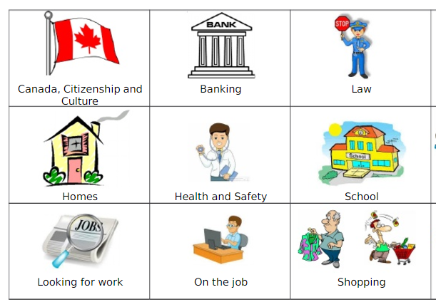
Needs Assessment
Figure out what themes, topics, and tasks your students need
Informs planning and teaching
Makes learning more meaningful and relevant for students
Very closely related with goal setting

Slide 18
PBLA Steps
Needs Assessment
Module Plans
Lesson/ Assessment Plans
Skill-Building Activities
Skill-Using Activities
Real-World Assessment Tasks
Portfolio Review

Slide 19
Resource
practicalpbla.weebly.com

Slide 20
More Resources
CLB 2012​
http://www.cic.gc.ca/english/pdf/pub/language-benchmarks.pdf​
​
CLB Support Kit​
http://www.language.ca/documents/CLB_Support_Kit_Website_1.pdf
​
PBLA Emerging practice Guidelines​
http://pblaepg.language.ca/​
Integrating CLB Assessment into your ESL Classroom​
http://iclba.language.ca/​

